Slide 1


How to Open Or Export CSV Files in Excel
Digital Business Ecosystem Research Center

Slide 2
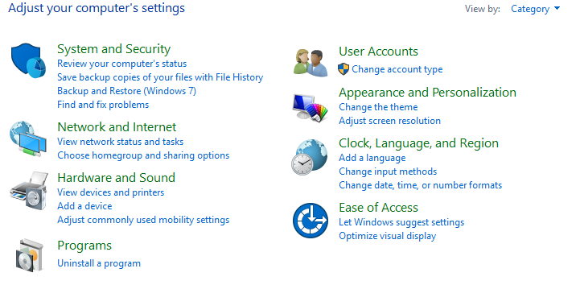

Open Control Panel > Clock, Language, and Region

Slide 3
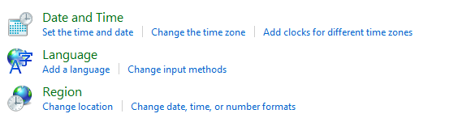
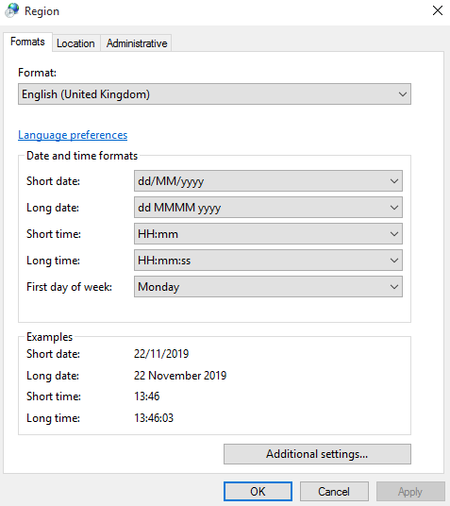
Click Region
Change the country format to English (United Kingdom)
Click Apply > OK

Slide 4

THANK YOU

